Slide 1

Traits of World Happiness

Slide 2

How geography, economics, health, education, and demographics impact happiness around the world.
by Ahasan Hossain, Chris Lichliter,
David Obembe, and Jack Tambert

Slide 3
You Can’t Buy Happiness
Alternatives to GDP for measuring the success of a country.
In 2008, Bhutan started measuring “Gross National Happiness” as part of a constitutional amendment. ^{i}
If happiness is a better measure of success, then what areas should a country focus on in order to improve its happiness?

Slide 4
Hypothesis
Countries that are wealthier, healthier, that have more beaches, woods, and mountains to play in, and more educated, will be happier.

Slide 5
Sources of Data
World Happiness Report: Data presented to the UN collected by Gallup World Poll. Sample populations around the world were asked "How would you rate your happiness on a scale of 0 to 10 where 10 is the happiest?". ^{ii}
CIA World Factbook: An almanac providing information on demographics, economics, geography, and government for 267 countries and entities. Converted into json by Ian Coleman. ^{iii}

Slide 6
Data Cleaning and Exploration
Happiness data: Happiness scores were grouped by country, and change in happiness score was plotted. Means for each country were them calculated to compare against each other, and data from the World Factbook.
World Factbook data: Cleaned format so country names would match with happiness data. Merged and removed null values. Looked at correlations between Happiness Score and variables from factbook.

Slide 7
Analysis
Explored how countries’ happiness changed over time to see if there were any drastic differences. And see what were the indicators
Calculated how each variable in the Factbook corelated to Happiness Score.
Created a multi-variable linear regression model to be able to predict a country’s happiness level if not included in the Gallup Poll.

Slide 8
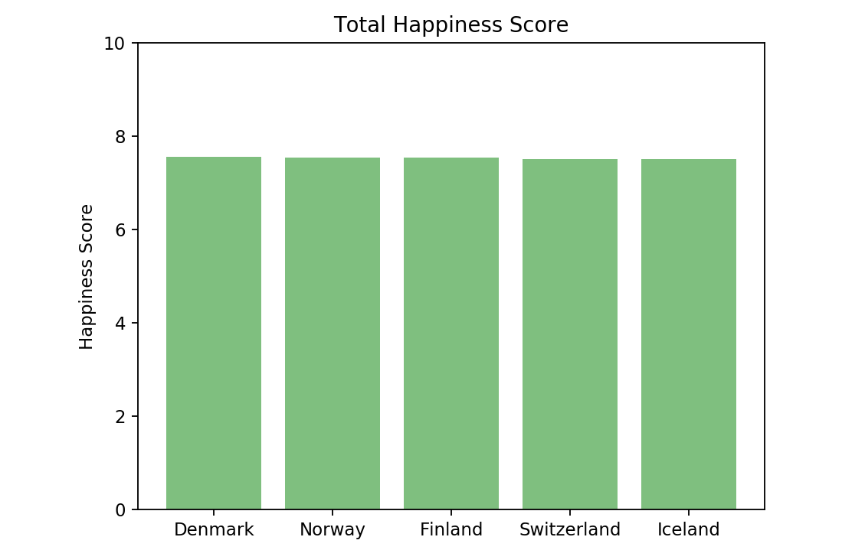
Most Happy Countries
No real way to make any form of comparative analysis just by looking at the top 5.
Limited to one year of data.
Look further into the top 5 with a line graph instead.

Slide 9
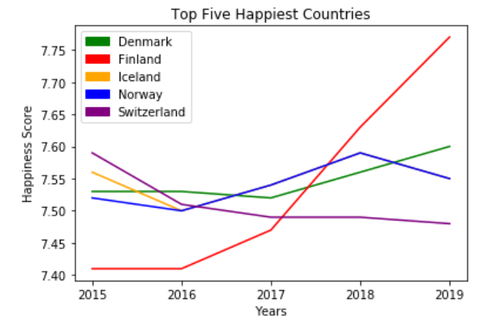
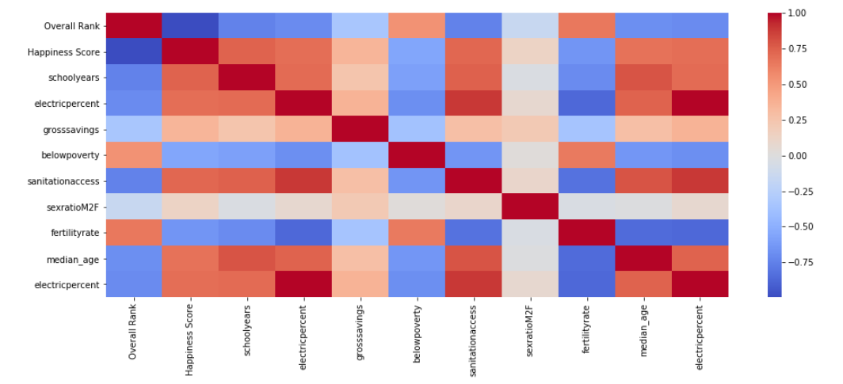
Most Happy Countries Timeline
Based on the graph we see that there is a spike of happiness in Finland in the past year.
We also see a dip in happiness with Norway in the past year.
Year to year changes tend to be small.
After conducting further research, Finland has shown more of an emphasis on education in recent years.
Which supports the argument that education caused the spike of happiness.

Slide 10
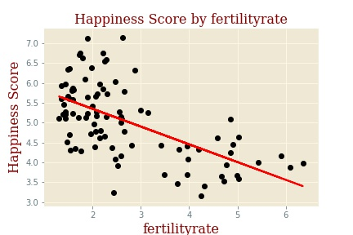
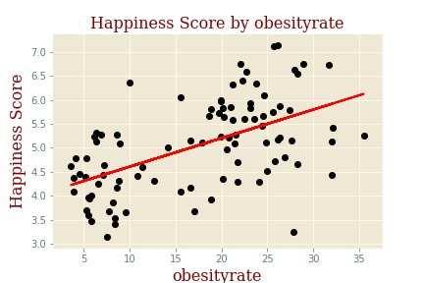
Health and Access Factors
Fertility Rate
Obesity Rate
Regression Line: y = x * -0.45 + 6.25
R-Sq = 0.36
Regression Line: y = x * 0.06+ 4.01
R-Sq = 0.30

Slide 11
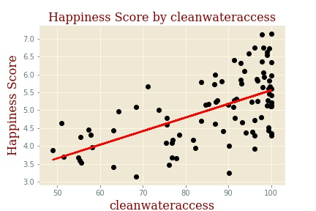
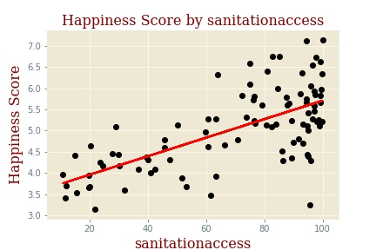
Access to Clean Water
Access to Sanitation
Regression Line: y = x * 0.04+ 1.75
R-Sq = 0.35
Regression Line: y = x * 0.022+ 3.52
RSq = 0.43

Slide 12
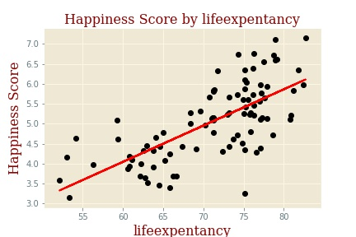
Life Expectancy
Regression Line: y = x * 0.09+ -1.40
R-Sq= 0.49

Slide 13
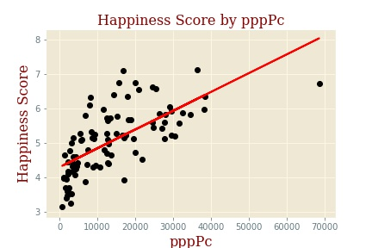
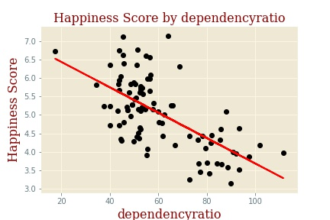
Economic and Demographic Factors vs Happiness Score
Purchasing Power Parity per Capita
Dependency Ratio
Regression Line: y = x * 5.47+ 4.30
R-Sq = 0.46
Regression Line: y = x * -0.03+ 7.12
R-Sq = 0.41

Slide 14
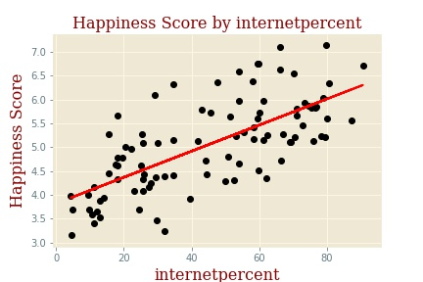
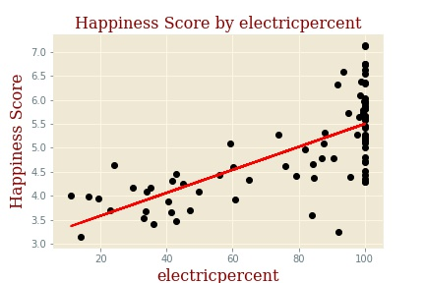
Internet Access
Electricity Access
Regression Line: y = x * 0.03+ 3.82
R-Sq = 0.48
Regression Line: y = x * 0.02+ 3.10
R-Sq = 0.49

Slide 15
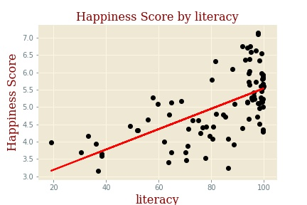
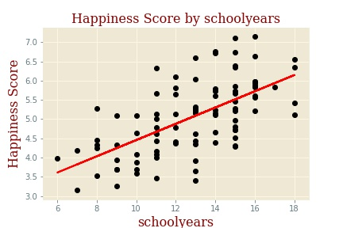
Educational Factors
Literacy Rate
School Years
Regression Line: y = x * 0.03+ 2.60
R-Sq = 0.38
Regression Line: y = x * 0.21+ 2.34
R-sq = 0.39

Slide 16
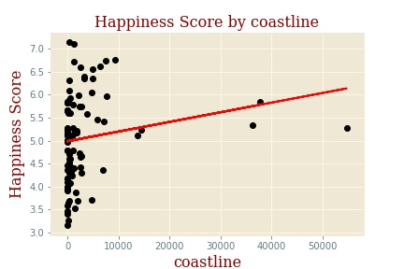
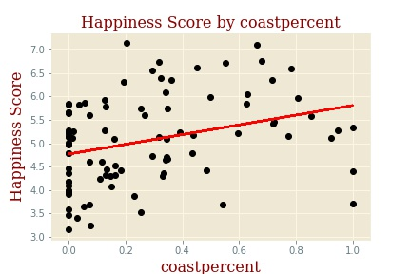
Geographic Factors
Coastline
Coastline as % of Borders
Regression Line: y = x * 2.10+ 4.99
R-Sq = 0.03
Regression Line: y = x * 1.04+ 4.77
R-Sq = 0.10

Slide 17
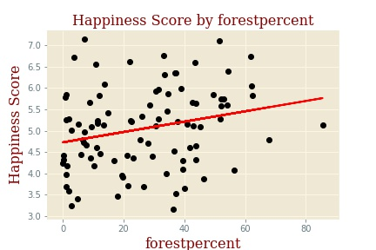
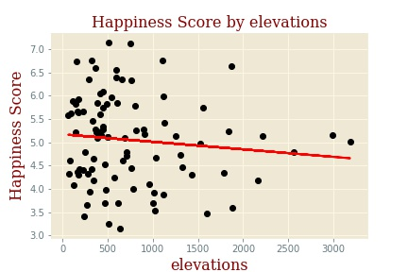
Forest as % of all land
Mean Elevation
Regression Line: y = x * 0.01+ 4.73
R-Sq = 0.06
Regression Line: y = x * -0.00+ 5.17
R-Sq = 0.01

Slide 18
Findings & Conclusions
Most countries do not vary much in happiness from one year to the next.
In general, health, economic and educational factors had moderate correlation with a country’s happiness.
In general, geography has a weak to no correlation with a country’s happiness.

Slide 19
Regression Model
Variables for model:
Percent of population with access to Electricity P Value = 0.00
Purchasing Power Parity per Capita P Value = 0.00
Gross National Savings P Value = 0.17
Unemployment P Value = 0.18
Forest as Percent of Land P Value = 0.05
Ratio of Males to Females P Value = 0.03
Dependency Ratio (non-working age to working age) P Value = 0.10
Median Age P Value = 0.00

Slide 20
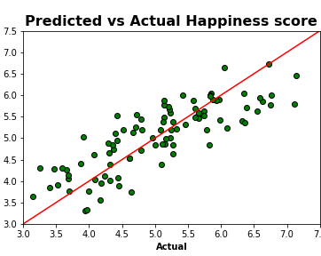
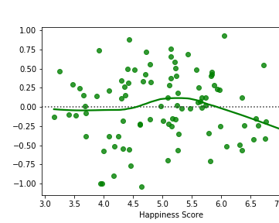
Predicted vs Actual Happiness Scores:
Residuals
R-Squared = 0.67
Adj. R-Squared = 0.64

Slide 21
Predicting Unknown Happiness
Barbados:
Prediction:
Electricity Access = 100%
pppPc = $18,600.00
Gross National Savings = 7.2%
Unemployment = 10.1%
Male to Female Ratio = 0.94
Dependency Ratio = 50.4
Median Age = 38.9
Forest as % of Land = 19.4
Happiness score of 5.31!

Slide 22
Limitations and Future Analysis
Happiness Score is inherently subjective.
How does annual weather corelate with happiness?

Slide 23


Slide 24
Sources
^{i} http://www.oecd.org/site/ssfc2011/48920513.pdf
^{ii} https://www.kaggle.com/unsdsn/world-happiness
^{iii} https://iancoleman.io/exploring-the-cia-world-factbook/
^{iV} https://www.youtube.com/watch?v=w41koarq85k

